Slide 1
Improving the Current Loop Bandwidth and Axis Decoupling for High Speed Electrical Drives Using Multisampled Control

Slide 2
Table of Contents
02
04
IMPLEMENTATION
DSP algorithm
Timings & averaging
FUTURE PLAN
INTRODUCTION
Goal & motivation
Limitations
CURRENT PROGRESS
Simulink
HIL
Analytics
01
03

Slide 3
Table of Contents
02
04
IMPLEMENTATION
DSP algorithm
Timings & averaging
FUTURE PLAN
INTRODUCTION
Goal & motivation
Limitations
CURRENT PROGRESS
Simulink
HIL
Analytics
01
03

Slide 4
Multisampling control - basics
i_{L,f} [k]
i_{L}(t)
Single Sampling Approach
f_{sampling} = f_{sw}
(k-1)T_{sw}
kT_{sw}
t
(k+1)T_{sw}
i_{L,f} [k]
i_{L}(t)
Multiple Sampling Approach
f_{sampling} = N·f_{sw}
(k-1)T_{sw}
kT_{sw}
t
(k+1)T_{sw}

Slide 5
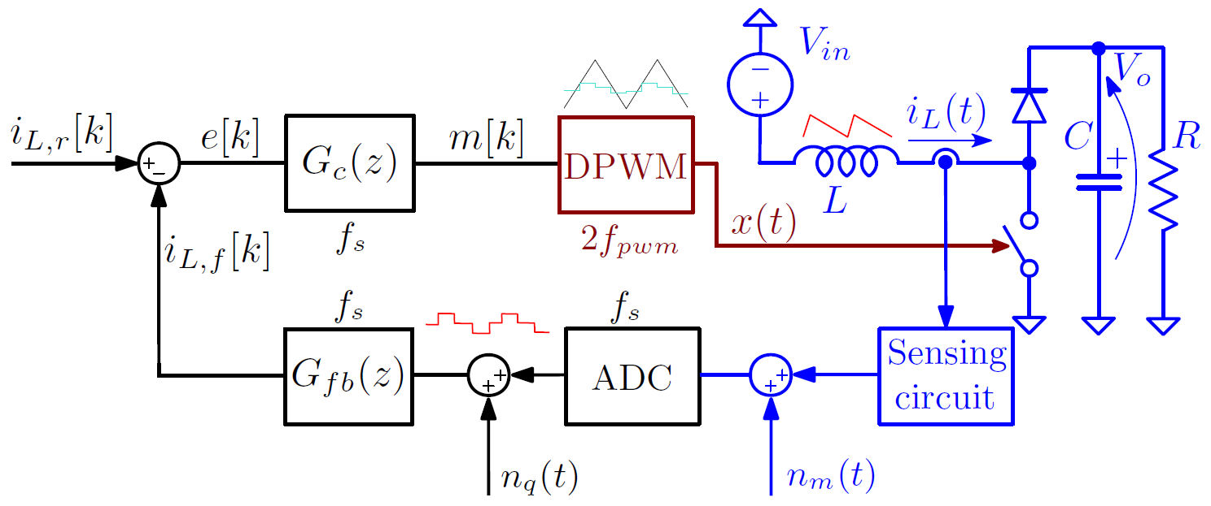
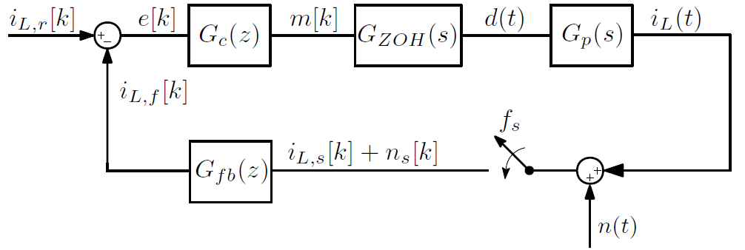
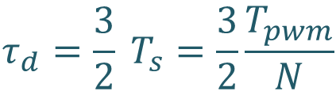
Multisampling - motivation
Combined DPWM and one-step computational delay is equal to:
$$τ_{d}=\frac{3}{2} T_{s}=\frac{3}{2}\frac{T_{pwm}}{N}$$
Digital delays are reduced!

Slide 6
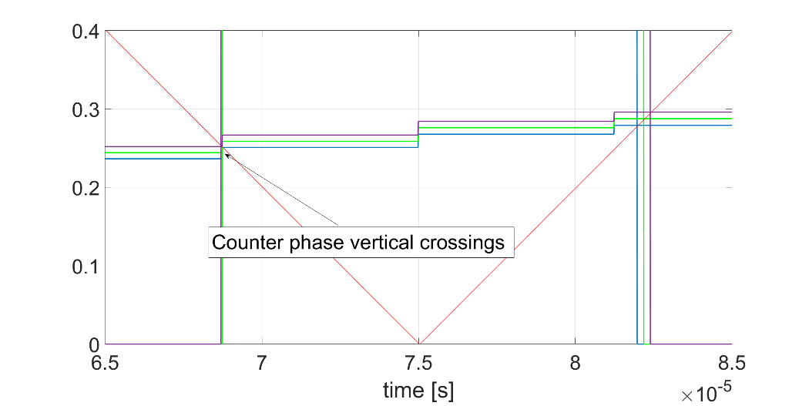
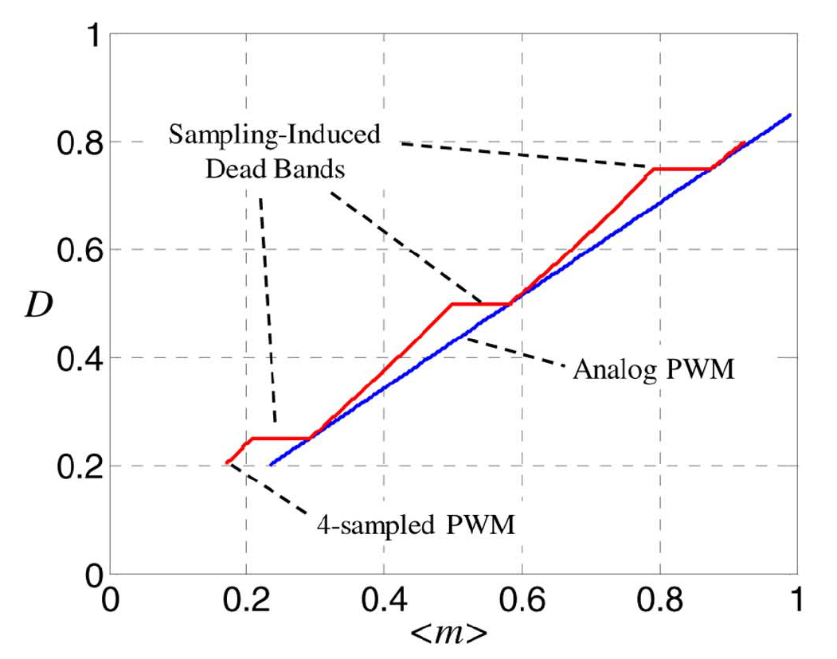
Multisampling - problems
Vertical crossings between modulating waveform and carrier introduce DPWM nonlinearity
Transcharacterisctics (D = f(<m>)) shows reduced gain regions [1]:
Gain = ½ for one edge vertical crossing
Gain = 0 for two edge vertical crossings
These are solved by using ripple filtering:
Repetitive filters [2]
less phase-lag
sensitive to noise
One-period averaging (MAFs)
better noise performance
In DSPs additional “trick” is needed as switching occurs when compare register is equal to the carrier (pulse skipping would occur at vertical crossings if this algorithm would not be implemented)
[1]: Corradini, L. and Mattavelli, P., 2008. Modeling of multisampled pulse width modulators for digitally controlled DC–DC converters. IEEE Transactions on Power Electronics, 23(4), pp.1839-1847.
[2]: Corradini, L., Mattavelli, P., Tedeschi, E. and Trevisan, D., 2008. High-bandwidth multisampled digitally controlled DC–DC converters using ripple compensation. IEEE Transactions on Industrial Electronics, 55(4), pp.1501-1508.

Slide 7
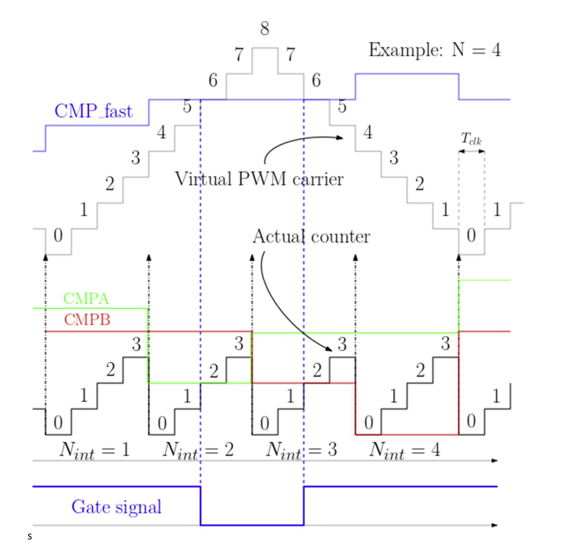
Bonus: Multisampling DSP algorithm
Example: UR=4
No missed edges due to vertical crossings
Only one ePWM module that runs on control frequency (UR*fpwm)
The maximum and minimum values of the virtual carrier, for the following control period are used to distinct cases with horizontal and vertical intersections with the virtual carrier

Slide 8
Table of Contents
02
04
IMPLEMENTATION
DSP algorithm
Timings & averaging
Parameter design
FUTURE PLAN
INTRODUCTION
Goal & motivation
Limitations
CURRENT PROGRESS
Simulink
HIL
01
03

Slide 9
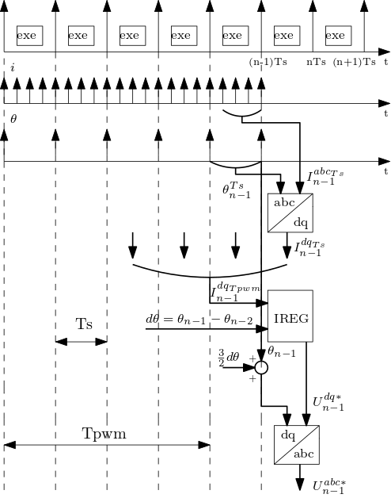
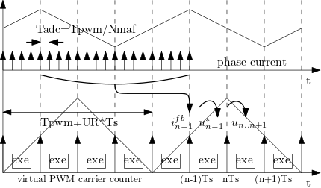
Proposed algorithm structure
Example: N = 4, Nmaf = 16
DSP uses DMA for high-frequency sampling (the same as in [3]), with rate Nmaf = Tsw / Tdma
Every Ts = Tsw / N, results from DMA are gathered
First they are averaged in alpha-beta frame over Ts
Second, this value is transformed to DQ frame using average of angles during previous Ts
Thirdly, these dq values are averaged in DQ frame over Tsw
The controller updates its output N times per Tsw
The controller structure is obtained using ZOH model (the same as in [3])
The gain alpha is chosen relative to new Ts (PWM frequency limits the bandwidth, not the sampling frequency)
[3]: Vukosavić, S.N., Perić, L.S. and Levi, E., 2015. AC current controller with error-free feedback acquisition system. IEEE Transactions on Energy Conversion, 31(1), pp.381-391.

Slide 10
Timings & averaging
Feedback averaging
Current: Moving Average Filter (MAF) over one switching period
Angle: averaging on regulation period
fpwm=10kHz, Nmaf=16, UR<=8

Slide 11
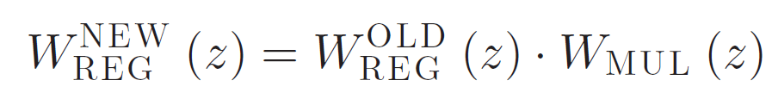
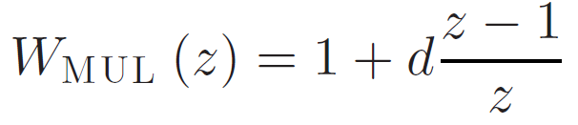
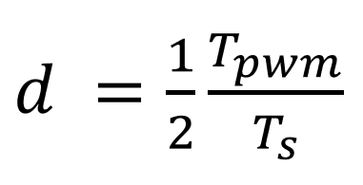
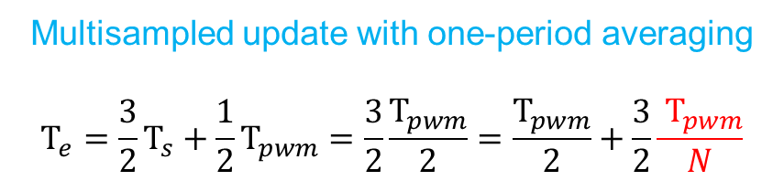
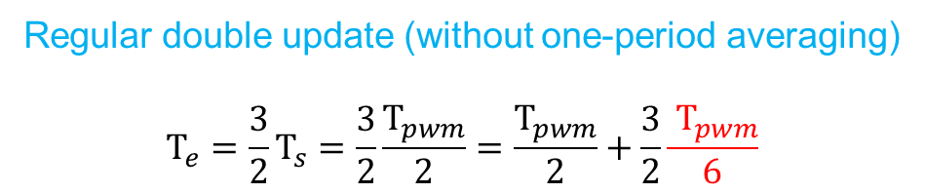
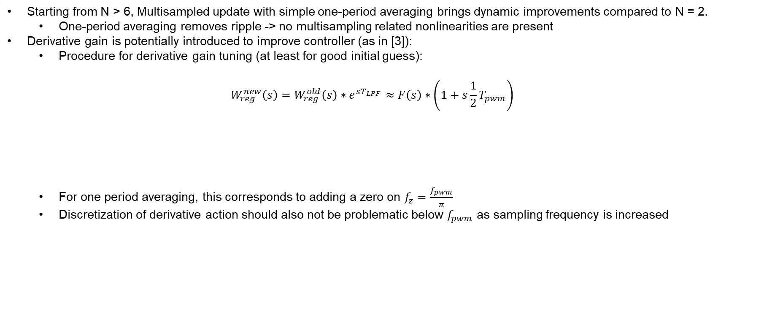
Time delay comparison
Control + DPWM equivalent time delay
One period averaging equivalent time delay
Regular double update (without one-period averaging)
$$Τ_{e}=\frac{3}{2}Τ_{s}=\frac{3}{2}\frac{Τ_{pwm}}{2}=\frac{Τ_{pwm}}{2}+\frac{3}{2}\frac{{ Τ}_{pwm}}{6}$$
Multisampled update with one-period averaging
$$Τ_{e}=\frac{3}{2}Τ_{s}+\frac{1}{2}Τ_{pwm}=\frac{3}{2}\frac{Τ_{pwm}}{2}=\frac{Τ_{pwm}}{2}+\frac{3}{2}\frac{{ Τ}_{pwm}}{N}$$
Starting from N > 6, Multisampled update with simple one-period averaging brings dynamic improvements compared to N = 2.
One-period averaging removes ripple -> no multisampling related nonlinearities are present
Derivative gain is potentially introduced to improve controller (as in [3]):
Procedure for derivative gain tuning (at least for good initial guess):
$$W_{reg}^{new}\left(s\right)=W_{reg}^{old}\left(s\right)∗e^{sT_{LPF}}≈F\left(s\right)∗\left(1+s\frac{1}{2}T_{pwm}\right)$$
For one period averaging, this corresponds to adding a zero on $f_{z}=\frac{f_{pwm}}{π}$
Discretization of derivative action should also not be problematic below $f_{pwm}$ as sampling frequency is increased

Slide 12
Target for publication
Benefits:
Reduced time delay -> better stability margins
Angle information is obtained multiple times per switching period
Averaging in dq frame as well (not only in alpha-beta and then transformed to dq)
Better decoupling capability
Demerits:
The model in z-domain now doesn’t completely match the large-signal system dynamics, due to fs > 2*fpwm (not every controller output modifies the PWM output).
Care should be taken in limiting the upper value of alpha, according to feasible bandwidths – limited by the fpwm.

Slide 13
Table of Contents
02
04
IMPLEMENTATION
DSP algorithm
Timings & averaging
Parameter design
FUTURE PLAN
INTRODUCTION
Goal & motivation
Limitations
CURRENT PROGRESS
Simulink
HIL
01
03

Slide 14
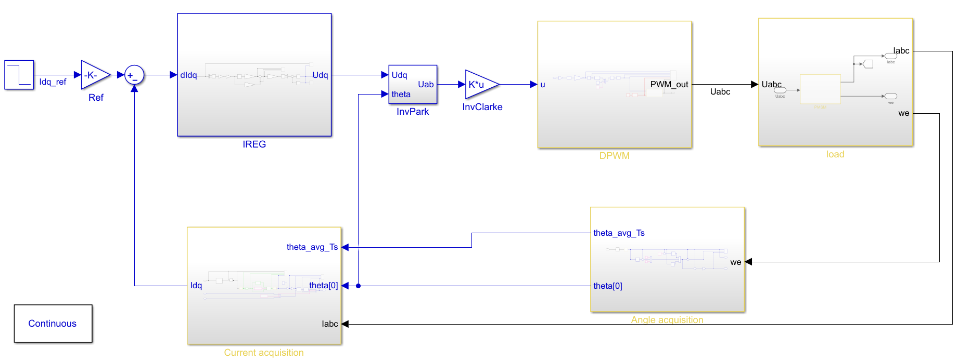
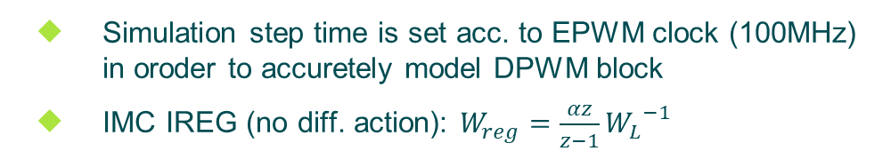
Current progress – Simulink (1)
Simulation step time is set acc. to EPWM clock (100MHz) in oroder to accuretely model DPWM block
IMC IREG (no diff. action): $W_{reg}=\frac{αz}{z−1}{W_{L}}^{−1}$
BLDC parameters (vukosavic2016.pdf):
Rs=0.47Ω, Ls=3.4mH, kemf=0.687 Vpeak/(rad/s), Inom=7.3A

Slide 15
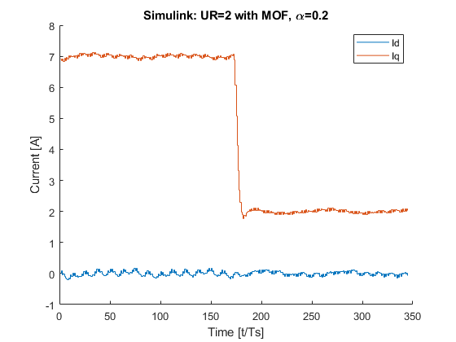
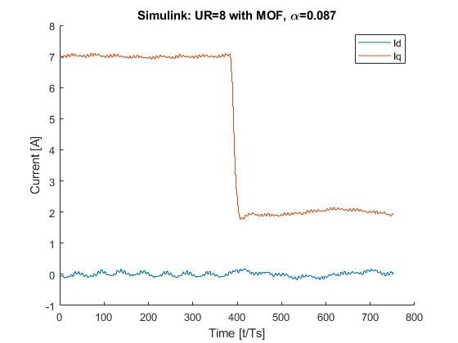
Current progress – Simulink (2)
DQ step response
UR=8 VS. UR=2 (both with MAF 16x)
For UR=8 α is set to obtain same overshoot as for UR=2 with alpha=0.2
Update rate (UR) | 2 | 8
MAF | yes | yes
α | 0.2 | 0.087
OS | 4.7% | 5%
T_rise(10% - 90 %) | 2.5 Tsw | 1.5 Tsw
Simulink: UR=2 with MAF, α=0.2
Simulink: UR=8 with MAF, α=0.087

Slide 16
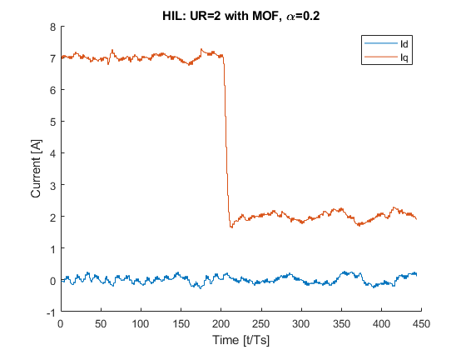
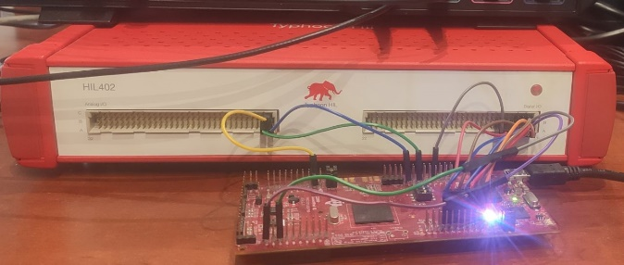
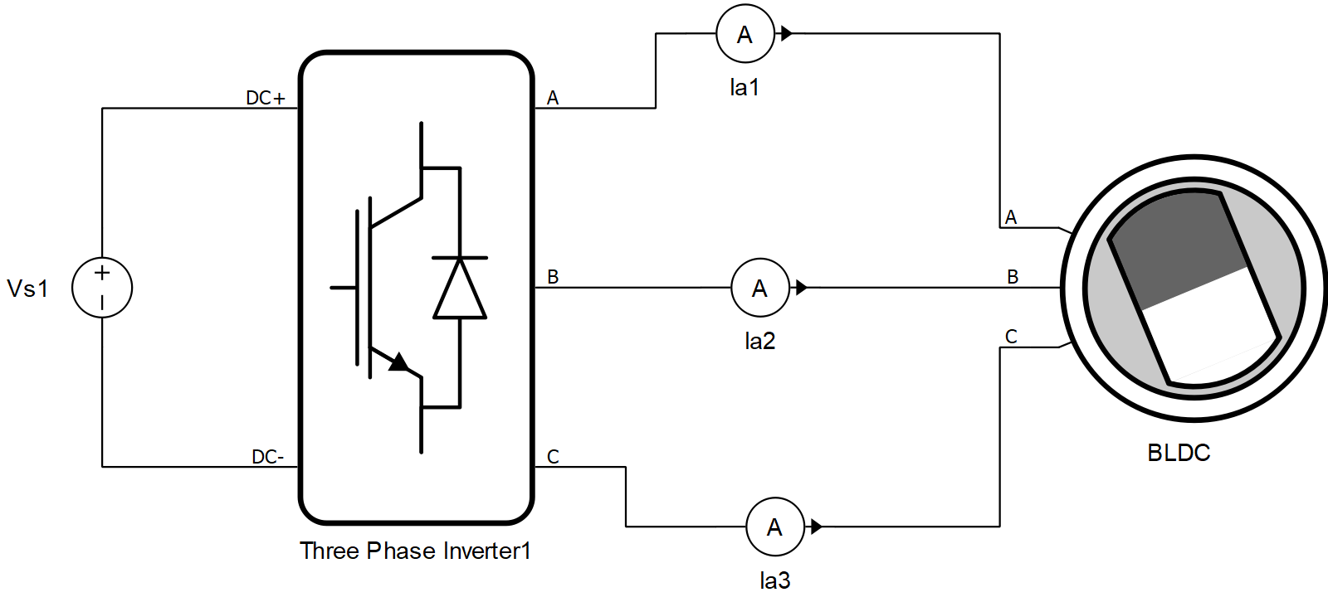
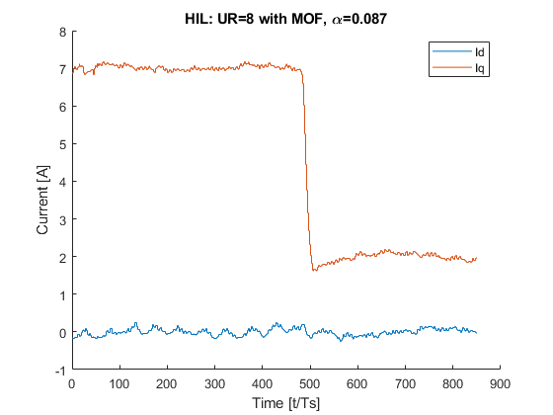
Current progress - HIL
HIL: UR=2 with MAF, α=0.2
Update rate (UR) | 2 | 8
MAF | yes | yes
α | 0.2 | 0.087
OS | 7% | 6.7%
T_rise(10% - 90 %) | 2.5 Tsw | 1.5 Tsw
Typhoon HIL 402 & F28379D launch pad
Similar parameter settings as in Simulink
Oscilations
@ fundamental
HIL: UR=8 with MAF, α=0.087
Oscilations
@ fundamental

Slide 17
Current progress and encountered problems
HIL: UR=2 with MAF, α=0.2
Derivative gain is not yet finely tuned
Goal is to obtain better results than N = 2 + derivative gain
Oscillations on fundamental frequency:
Present also for N = 2 with averaging (so not related to multisampling)
Best way to point in the paper?
Go for the same bandwidth as in [4] with higher stability margin?
Test decoupling at very high speeds (RL load)?
HIL: UR=8 with MAF, α=0.087
[4]: Vukosavić, S.N., Perić, L.S. and Levi, E., 2016. A three-phase digital current controller with improved performance indices. IEEE Transactions on Energy Conversion, 32(1), pp.184-193.

Slide 18
Table of Contents
02
04
IMPLEMENTATION
DSP algorithm
Timings & averaging
Parameter design
FUTURE PLAN
INTRODUCTION
Goal & motivation
Limitations
CURRENT PROGRESS
Simulink
HIL
01
03

Slide 19
Future work
Idq oscillations
@ fundamental
Location of best validation “target” for publication
Experimental
validation

Slide 20
Work plan and help needed
Experimental testing environment
Ruzica can perform the tests
TI f28379D (code is ready)
MOOG inverter
Help needed to properly place the paper + all ideas / critiques are welcome
I talked about this with Paolo and Simone Buso, and they fully support if we want to collaborate (UniPD + ETF Bgd) as this is directly related to my PhD (my plan is to later also investigate multisampling benefits for passivity of grid-connected converters due to reduced delays).

